Slide 1

Project Report :
House Price Prediction
By: Deepak singh

Slide 2

Housing Project
Outline
introduction.
Business Problem Statement.
Problem Understanding.
Housing Price Prediction ?
Exploratory data analysis.
Visualizations/ Analysis
Observations
Data cleaning and Model Building.
Hyper Parameter Tuning.
Saving the model and predictions from saved best model.
Conclusion

Slide 3

introduction
Housing is one out of the 3 basic needs for human survival hence research about housing and all that relates to it can never be over emphasized.
In this particular presentation we will be looking on:
How to analyze the dataset for housing price prediction.
What are the EDA steps in cleaning the dataset.
Overall analysis on the problem.
Model building from train dataset.
Predicting housing price for test dataset

Slide 4

Business Problem Statement
Houses are one of the necessary need of each and every person around the globe and therefore housing and real estate market is one of the markets which is one of the major contributors in the world’s economy.
A us-based housing company named surprise housing has decided to enter the Australian market. The company uses data analytics to purchase houses at a price below their actual values and flip them at a higher price. For the same purpose, the company has collected a data set from the sale of houses in Australia. The data is provided in CSV
The company is looking at prospective properties to buy houses to enter the market. You are required to build a model using machine learning in order to predict the actual value of the prospective properties and decide whether to invest in them or not. For this company wants to know:
• which variables are important to predict the price of variable?
• How do these variables describe the price of the house?

Slide 5
Problem Understanding
House price prediction, is important to drive real estate efficiency. As earlier, house prices were determined by calculating the acquiring and selling price in a locality. Therefore, the house price prediction model is very essential in filling the information gap and improve real estate efficiency.
There are different raw data are available for real estate and applying data science to it, will move this industry at a next level. We can get the understanding of past, present and the future in real estate market analysing previous market trends and price ranges, and also upcoming developments future prices will be predicted Today in fast moving world this could be a great investment for business. To beat the market there is requirement to understanding the value of data science in the field of real estate.

Slide 6
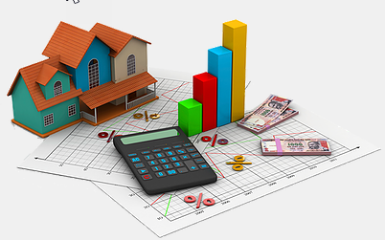
Housing Price Prediction?
Prediction house prices are expected to help people who plan to buy a house .
Predicting house prices can help to determine the selling price of a house of a particular region and can help people to find the right time to buy a home.
House Price Prediction using machine learning, our task is to use data from the Australia census to create a machine learning model to predict house prices in the country. The data includes features such as population, geographical condition, median income, and median house prices for each block group in Australia.

Slide 7
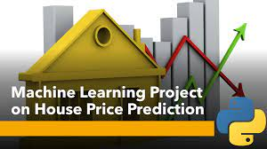
Exploratory data analysis.
Steps Involved:
Importing the required packages into our python environment
Importing the house price data and do some EDA on it
Data Visualization on the house price data
Feature Selection & Data Split
Modeling the data using the algorithms
Evaluating the built model using the evaluation metrics

Slide 8
Exploratory data analysis.
This is the Importing section shows the exploration done on the dataset, which is what motivated the use of the algorithm.
Is there a significant relationship between sale price and building's age?
What is the sale price distribution based on the overall quality of the house?
What categories of house (based on age built) have the highest sale price?
Sale Price versus Month it was sold.
What sale type has the highest sale price? There are 9 different types of sales type that was considered against the sale price
At what price will people buy more even with garage attached?
Sales per seasons. The probability of people buying houses?

Slide 9
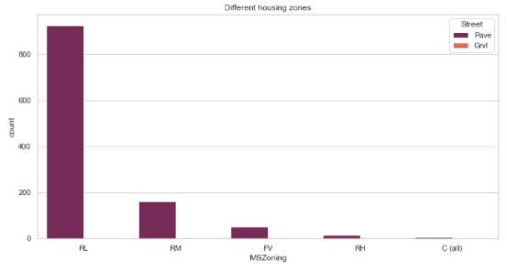
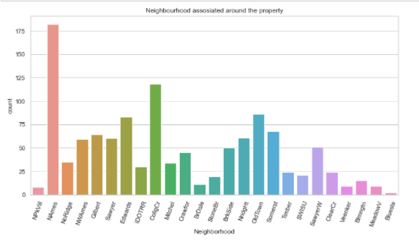
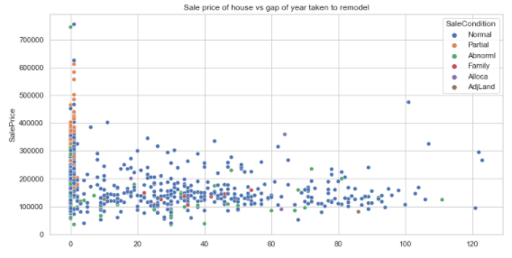
Visualizations
Neighbourhoods
identify the zoning area of the properties
Sales Price pre year

Slide 10
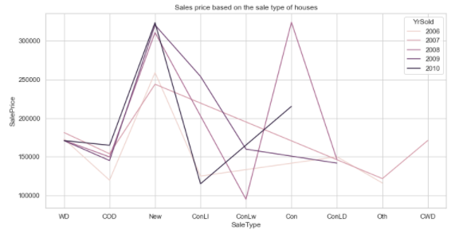
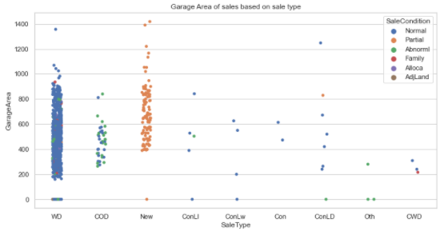
Analysis
SalesType and SalesPrice
SalesCondition based on GarageArea & sales type

Slide 11
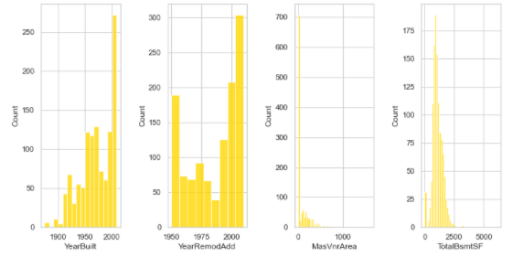
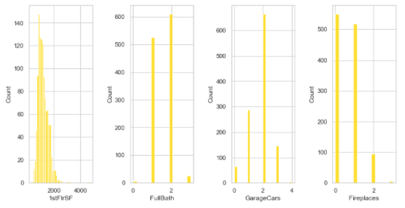
Relationship between the target variable and the variables that are positively correlated with it. I have used different plot for each pair of categorical features that shows the relation with the median sale price for all the sub categories in each categorical feature.

Slide 12
Observations
As Linear feet of street connected to property(LotFrontage) is increseing sales is decreasing and the SalePrice is rangeing between 0-3 lakhs.
We can see that the roadways or streets seems to play an important role.Houses / properties that are in neighborhoods, condos, villa's etc fetch good amount of values and if it was remodelled or partially completed it seems to get even higher sale to some extent.
As Lot size in square feet(LotArea) is increseing sales is decreasing and the saleprice is in between 0-4 lakhs.
Area in square feet(MasVnrArea) is increasing sales is decreasing and saleprice is rangeing between 0-4 lakhs.
A downpayment is possible if the person looking forward to purchase has a steady income. Higher the downpayment, better the loan rates.
Unfinished square feet of basement area(BsmtUnfSF) is increseing sales is decreasing and the saleprice is in between 0-4 lakhs.
Total square feet of basement area(TotalBsmtSF) is increseing sales is decreasing and the saleprice is in between 0-4 lakhs.
First Floor square feet(1stFlrSF) is increseing sales is decreasing and the saleprice is in between 0-4 lakhs.
Above grade (ground) living area square feet(GrLivArea) is increseing sales is decreasing and the saleprice is in between 0-4 lakhs.
As Size of garage in square feet(GarageArea) is increseing sales is increseing and the saleprice is in between 0-4 lakhs.
Since Year garage was built(GarageAge) is increseing sales is decreasing and the saleprice is in between 0-4 lakhs.

Slide 13
Data cleaning
In my datasets I found null values, outliers and remove them.
I have used imputation method to replace null values. To remove outliers I have used percentile method, I have used yeo-johnson method.
To encode the categorical columns I have use Ordinal Encoding.
Use of Pearson’s correlation coefficient to check the correlation between dependent and independent features.
Have used cross-validation for perfect model building
Also I have used standardization. Then followed by model building with all regression algorithms.

Slide 14

Model Building
To get saleprice was my target and it was a continuous column so this perticular problem was regression problem. And I have used all regression algorithms to build my model. By looking into the difference of r2 score and cross validation score I found randomforestRegressor as a best model with least difference. Also to get the best model we have to run through multiple models and to avoid the confusion of overfitting we have go through cross validation

Slide 15
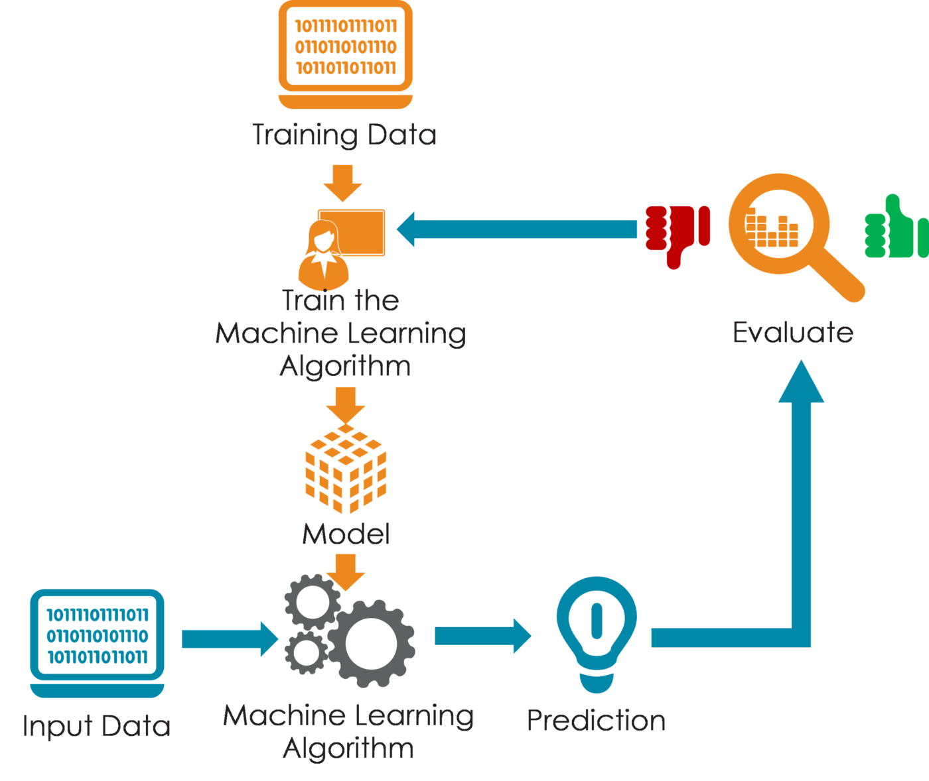
Model Building Algorithms
Below down all the algorithms used for the training and testing.
Using below algorithms for model building :
K-Neighbors Regressor
Decision Tree Regressor
Random Forest Regressor
Extra Trees Regressor

Slide 16
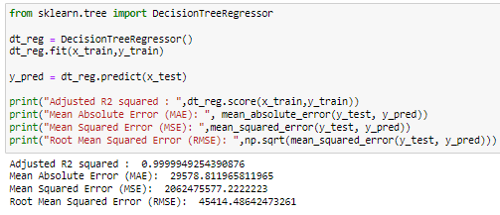
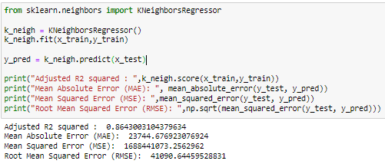
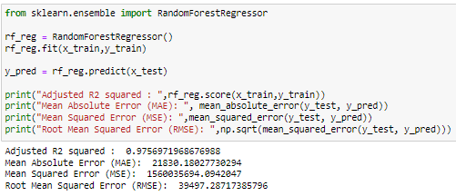
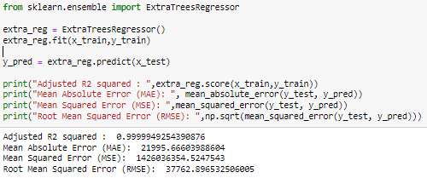

Slide 17
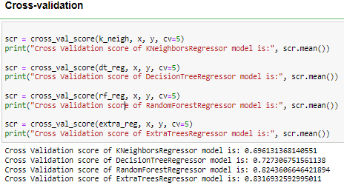
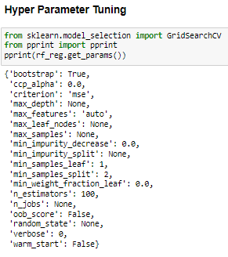
Cross validation & Hyper Parameter Tuning.

Slide 18
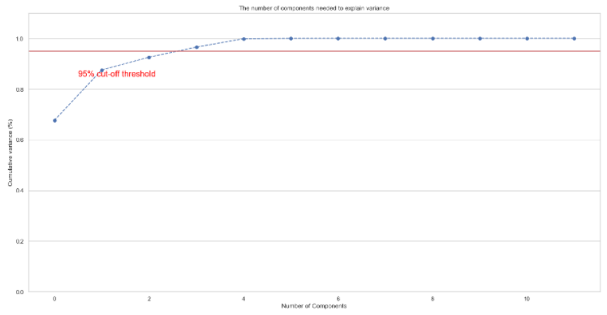
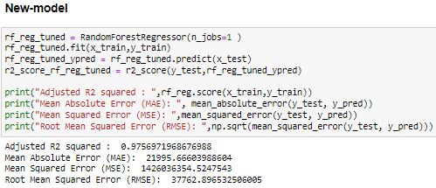
Saving the model and predictions from saved best model.
New Model
PCA

Slide 19
Conclusion
In conclusion after reviewing the above papers the first thing I noticed with the dataset is that a lot of research has been done on Australian houses. Also different algorithms have been used to predict housing prices but the most efficient one is regression of which my research work will perform on this dataset using different regression algorithms and present the result to know which gives the best accuracy using the R-squared and RMSE value.
Calculated the performance of each model using different performance metrics and compared them based on these metrics.
It is seen that different machine learning algorithms have been used to predict housing prices; as well as the different steps taken for the visualization of the dataset and finding co-relation between them.
There were large no. of feature present in our datasset, i anlyse the data and droped all the unnecessary.
From overall analysis and visualization i come into conclusion that , the feature that most effect the sales price of a property are: OverallQual, GrLiveArea, ExterQual, KitchenQual, BsmtQual, GarageCars, GarageArea, TotalBsmtSF, 1stFirSF, FullBath, KitchenAbvGr,, Year_SinceBuilt

Slide 20


